Slide 1
NextRoom
temporary name
Alireza Iran Pour
Nicolò Palmiero
Luigi Sigillo
Supervisor: Joy Abi Rizk
Repository
https://github.com/LuigiSigillo/IotBigProject

Slide 2
The Idea
Our idea is to build a web application that runs on your smartphone
During a tour in the Sapienza “Museo dell'Arte Classica”, it can suggest the next section you could visit based on the time you have spent in the previous sections
The application will display a preview of the suggested section, so that the user could choose to follow it or to jump to another suggestion.
A user can run the web application for all the duration of the museum tour
The smartphone starts collecting data, in an anonymous way, to make the best suggestions for every user
The suggestions are sent every time a user is leaving a section

Slide 3
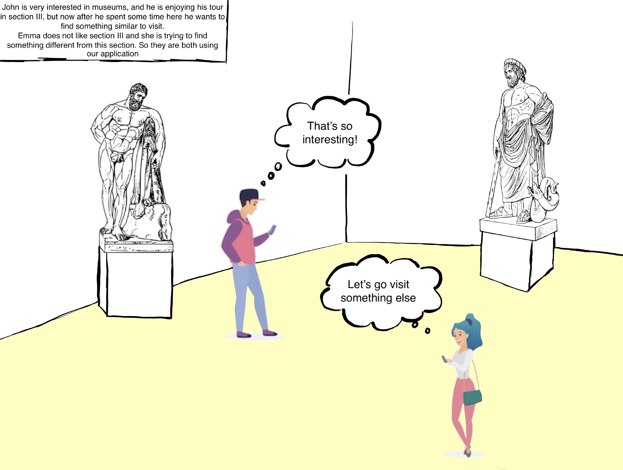
A Possible Scenario

Slide 4
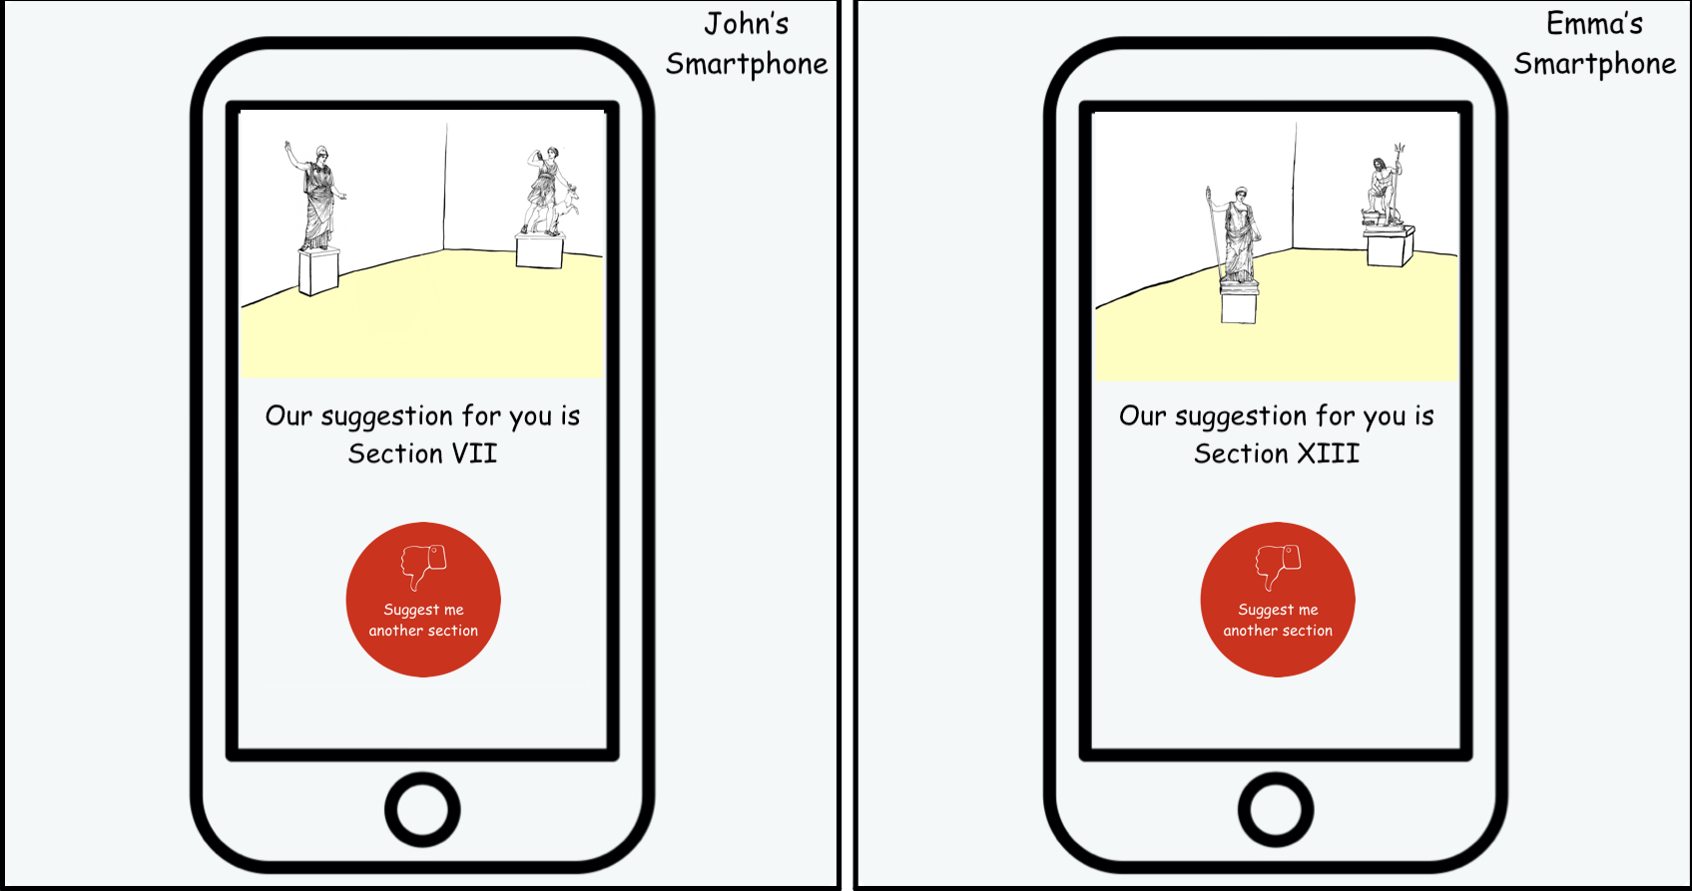
A Possible Scenario

Slide 5
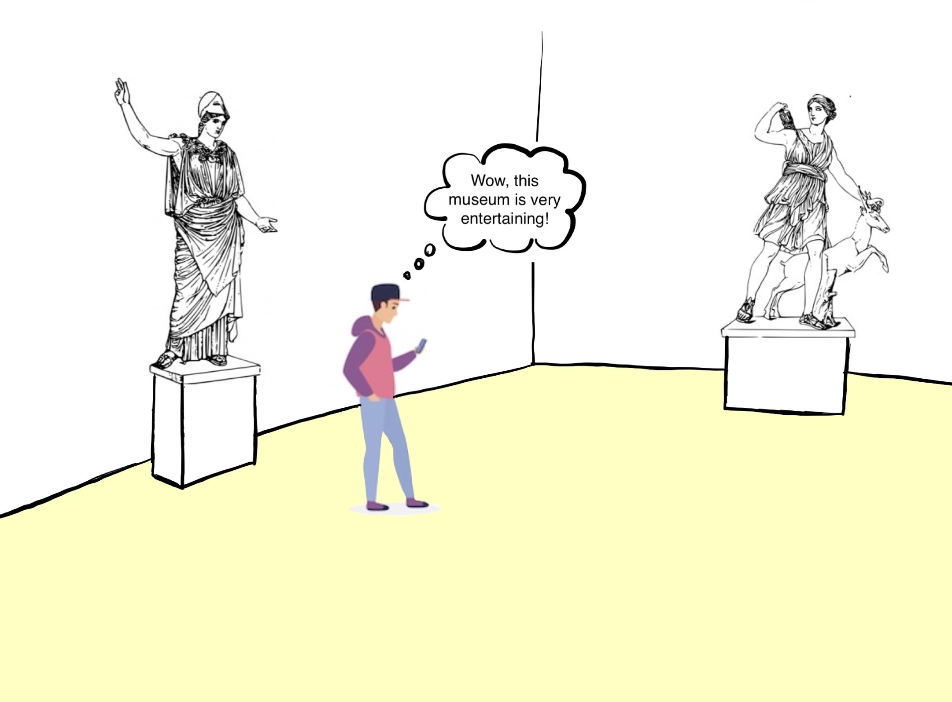
A Possible Scenario

Slide 6
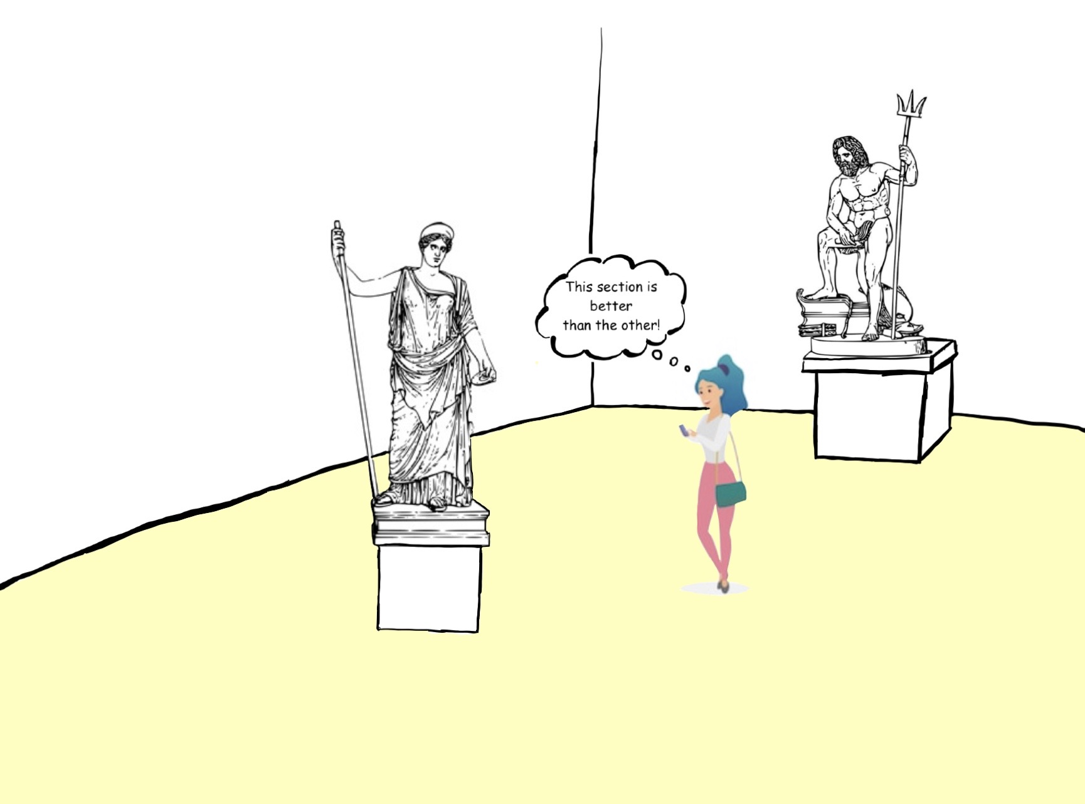
A Possible Scenario

Slide 7
User Experience Evaluation
We are planning evaluate the user experience using mockups, and after every demo of these prototypes we will collect people's opinions asking for feedbacks and publishing some google forms.
The questions will be mainly on:
User interface
Application services

Slide 8
Technical Evaluation
We will do a technical evaluation performing load tests on all parts of our system:
BLE IoT device-Smartphone interation: how many smartphones a single device can handle?
Cloud IoT device-Cloud interation: what is the message rate with which the device can send messages to Azure IoT hub?
Responsiveness Cloud-Smartphone interation: how fast the smatphone receives the advice on where to go, does it depend from the number of connected devices?

Slide 9
Architecture

Slide 10
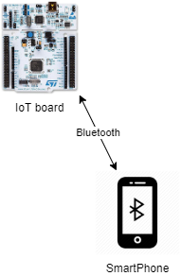
Typical scenario
BLE technology
Bluetooth beacon functionality

Slide 11
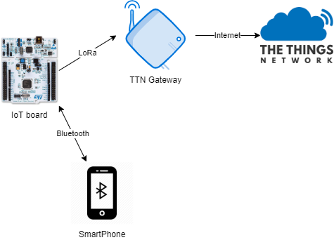
The Things Network
LoRaWAN technology
The Things Network services

Slide 12
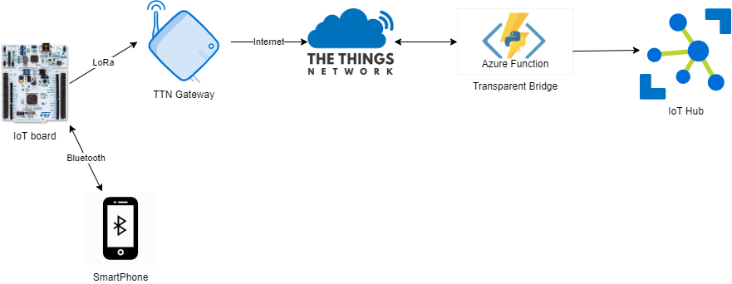
Cloud Services
Azure Cloud services
Azure Function
Azure IoT Hub
Azure SQL DB

Slide 13
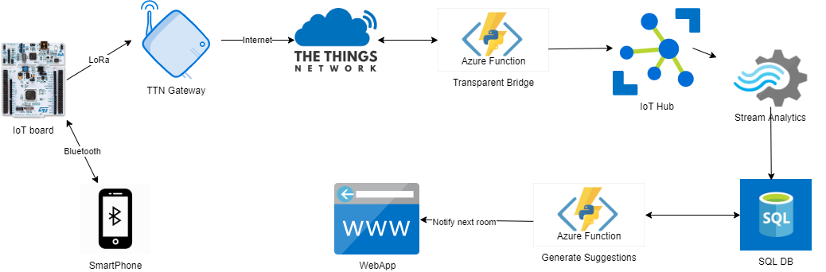
The complete flow
Web Application

Slide 14
Thank you for listening

